Slide 1






Cattaraugus County
Department of Economic Development, Planning & Tourism
Procurement Technical Assistance Center

Slide 2
Government Contracting
Every 20 seconds of each working day, the U.S. Government awards a contract worth an average of $465,000.00. The Federal Government issues over $260 billion in contracts annually. State Governments issue another $300 billion in contracts annually. Local Municipal Governments issue over $200 billion in contracts annually. Combined Federal, State & Local Governments spend an impressive $800 billion annually, making the United States Government the largest business in the world.

Slide 3
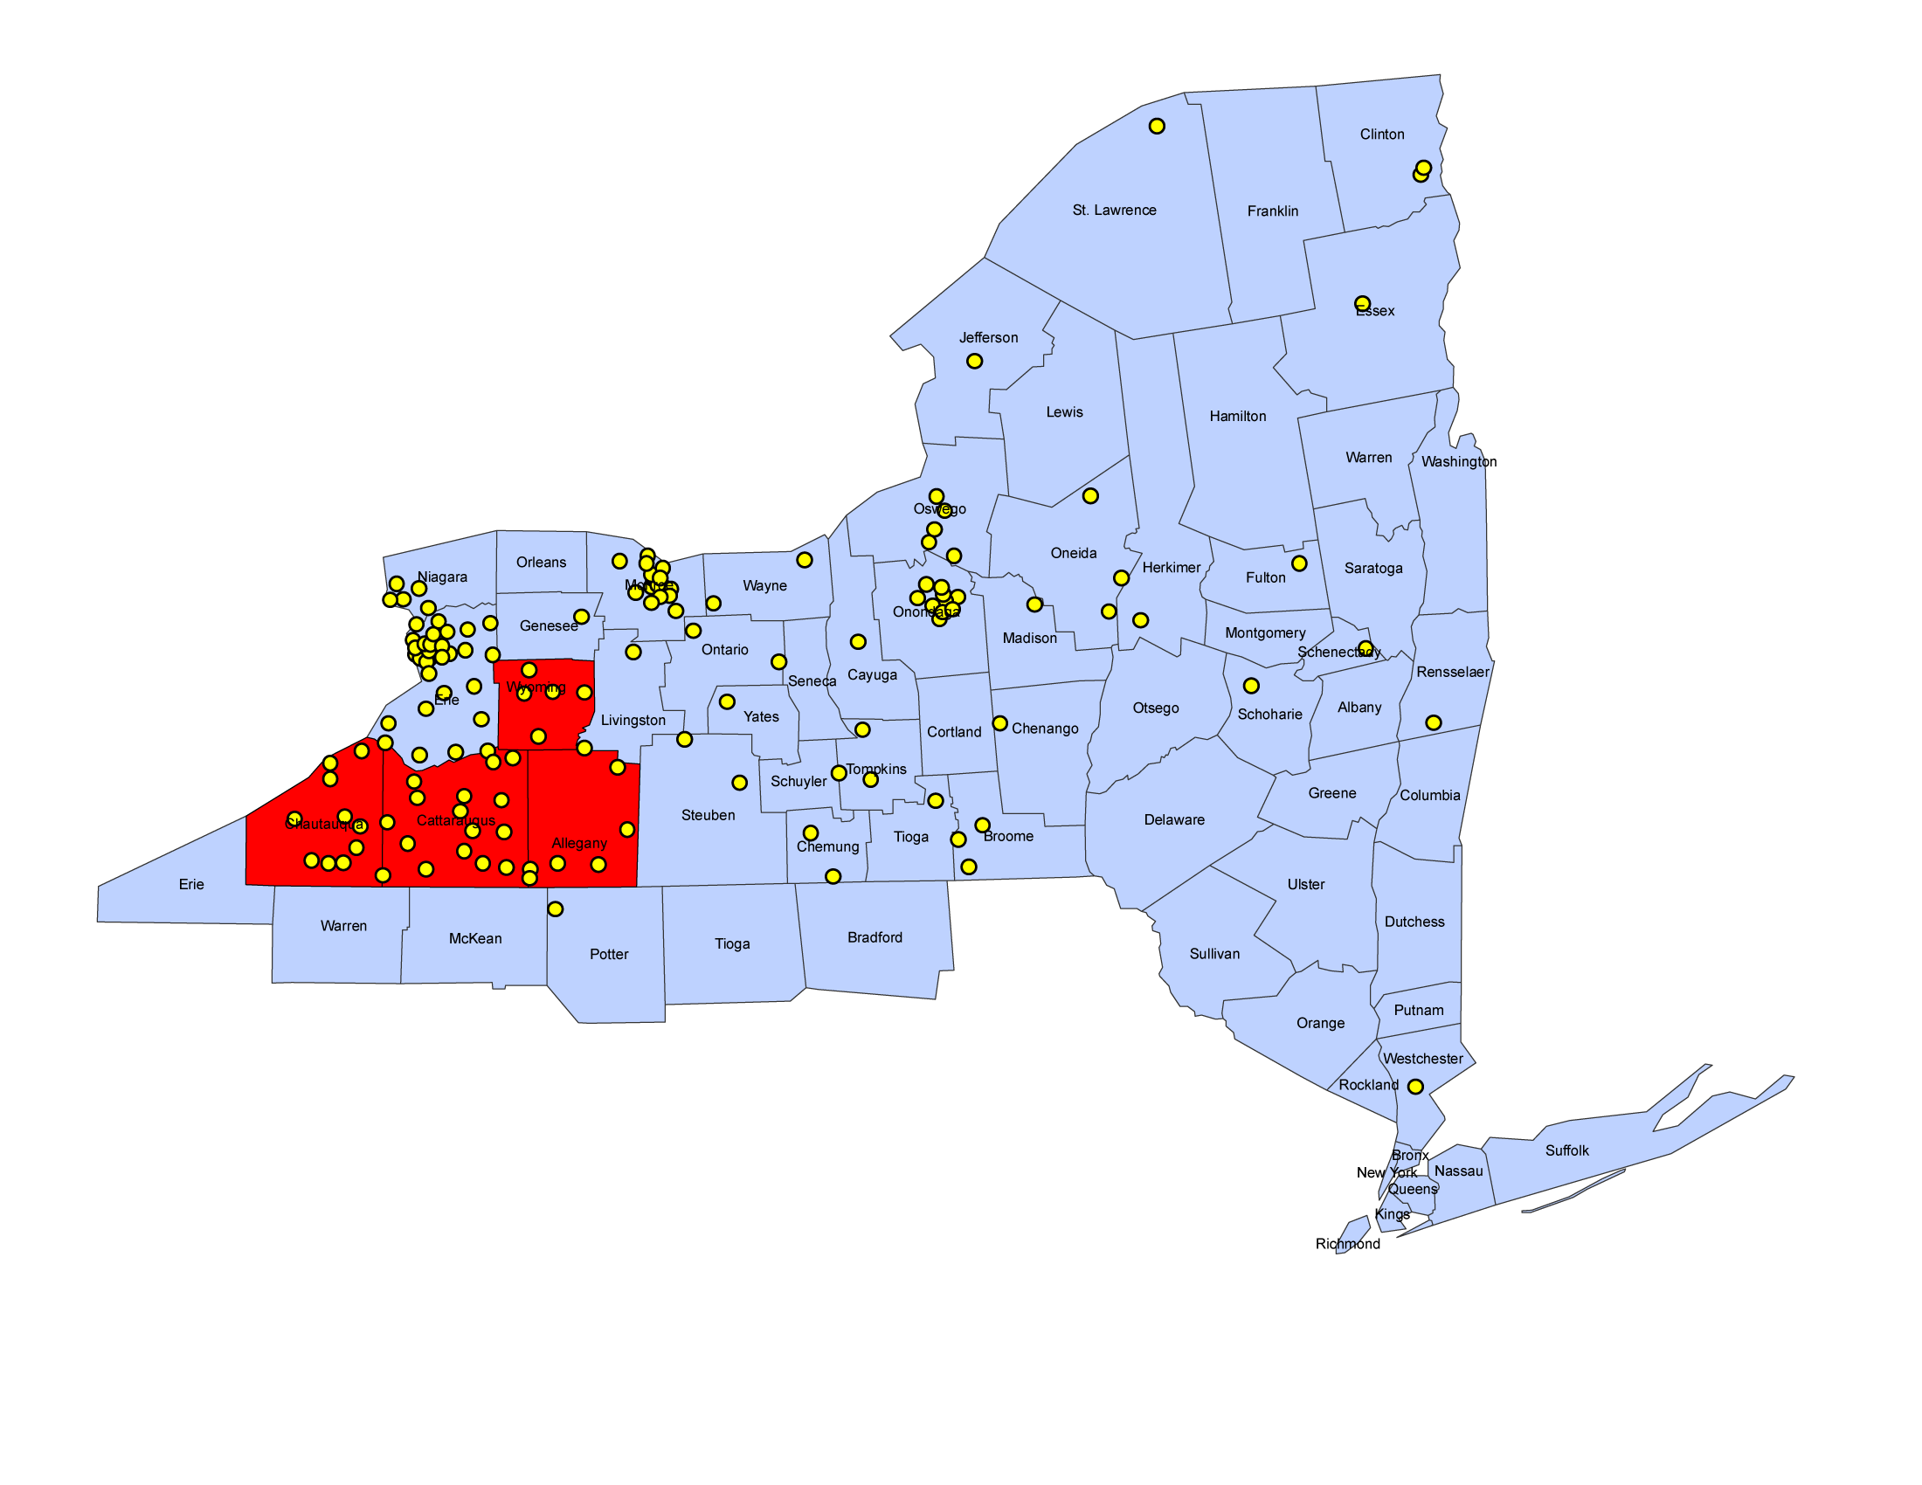
What is the PTAC ?
The Cattaraugus County Department of Economic Development, Planning & Tourism administers a NO COST government marketing and technical assistance program as one of the special economic development projects offered to help businesses of the county and region.
Service area is the four county region of Allegany, Cattaraugus, Chautauqua and Wyoming Counties in Southwestern New York State.
There are currently 7 PTACs located in NY State. NY City, Long Island City, Pearl River, Bronx, Rochester, Catt Co., & Watertown

Slide 4
Objectives of the PTAC
Assist businesses in marketing goods and services to the military, other federal, state and local government agencies.
Provides help with a wide variety of contracting topics.
Serve as an information source for special contracting programs dealing with HUBZone, 8(a), Veterans and E-Commerce.

Slide 5
Bid Matching Services
The Cattaraugus County PTAC Program offers military, other federal, state and some local government bid matching on a daily basis through the use of a computerized data sort and electronic mailbox system.
The search engine uses keywords and/or NAICS – SIC – FSC – NSN codes
We can also mail your solicitations

Slide 6
Doing Business with the DoD
Step 1: Identify your product or service.
It is helpful to know the Federal Supply Classification (FSC) Code and North American Industry Classification System (NAICS) Code for your product or service. Many government product/service listings and future procurements are identified according to the FSC Code (http://www.drms.dla.mil/htbin/fscsearch.pl)
or NAICS Code (http://www.census.gov/epcd/www/naics.html).
or these sites:
FSC codes - http://www.usabid.com/resources/tables/pscs/
SIC codes - http://www.usabid.com/resources/tables/sic/
NAICS - http://www.naics.com/search.htm
Notes:
FSC (Federal Supply Code). SIC (Standard Industry Code), NAICS (North America Indusry Classification Code). Review the links and show them how the usabid site works.

Slide 7
Doing Business with the DoD
Step 2: Obtain a Data Universal Numbering System (DUNS) Number and register in the Central Contractor Registration (CCR) System.
If you do not have a DUNS Number, contact Dun and Bradstreet to obtain one.
You must be registered in the CCR System (www.ccr.gov) to be awarded a contract by the DoD. The CCR System is a database designed to hold information relevant to procurement and financial transactions. The CCR System affords you the opportunity for fast electronic payment of your invoices..
http://www.ccr.gov
www.dnb.com
Notes:
DUNS number is free. The web site is very confusing.

Slide 8
Doing Business with the DoD
Step 3: Vendors must obtain a Contractor and Government Entity Code (CAGE) or NATO Contractor and Government Entity (NCAGE) Code.
The CAGE Code (for U.S. vendors) and NCAGE Code (for foreign vendors) is a required piece of data for registering in the CCR system. If you are a vendor located in the U.S. and do not have a CAGE Code, a CAGE Code will be assigned to you when you register in the CCR system for the first time. A foreign vendor must contact its country representative to receive its NCAGE Code assignment.
The CAGE Welcome information page is at:
http://www.dlis.dla.mil/cage_welcome.asp
A list of country representatives can be found at:
http://www.dlis.dla.mil/nato_poc.asp.
The NCAGE Code request form is at:
http://www.dlis.dla.mil/Forms/Form_AC135.asp
https://orca.bpn.gov/
Notes:
A unique 5 digit alpha-numeric number that the federal government uses to identify your business. Show how to do a look up on the CAGE site. County of Cattaraugus.
Some agencies also request businesses to register on the on ORCA web site (Online Representations and Certifications Application.) Prior to ORCA, vendors were required to submit Reps and Certs for each individual large purchase contract award. Now, using ORCA, a contractor can enter their Reps and Certs information once for use on all Federal contracts. This site not only benefits the contractor by allowing them to maintain an accurate and complete record but also the Contracting Officer as they can view every record, including archives, with the click of a mouse.

Slide 9
Doing Business with the DoD
Step 4: If you are a small business, explore programs with the Small Business Administration (SBA).
The SBA (www.sba.gov) offers assistance and certification in preference programs to small business concerns. We encourage you to determine if your firm qualifies for section 8(a), small disadvantaged business, HUBZone, or service-disabled veteran-owned small business certification while visiting the SBA website:
http://www.sba.gov/services/contractingopportunities/basics/identify/index.html
This site provides information about other SBA resources including Small Business Development Centers, Service Corps of Retired Executives (SCORE), and Women's Business Development Centers.
http://www.sba.gov/services/counseling/index.html
Notes:
Show the sites and the different links to use.

Slide 10
Doing Business with the DoD
Step 5: Identify current DoD procurement opportunities.
Identify current DoD and Federal procurement opportunities in your product or service area by checking the Federal Business Opportunities website: www.fedbizopps.gov. Since many contracting offices also may have their own procurement websites, check with individual contracting offices for other possible sources of information as well.
Step 6: Familiarize yourself with DoD contracting regulations and procedures.
Familiarize yourself with the Federal Acquisition Regulation (FAR) (http://www.arnet.gov/far) and the Defense Federal Acquisition Regulation Supplement (DFARS) (http://www.acq.osd.mil/dpap/dars/dfars/index.htm
Statistical Information Analysis Division produces an annual report of products and services purchased each fiscal year by the DoD at: http://siadapp.dior.whs.mil/procurement/Procurement.html
Data is sorted by FSC Codes and provide name and location of the corresponding DoD contracting office. This data can assist your marketing efforts.
Notes:
The fedbizopps will give you a large number of notices because the search is very broad. Some agencies have their own web site. If you are interested in doing business with a particular agency, it is recommended to check their site and register.
FAR’s – I recommend that clients use a data base or spreadsheet to keep track of the FARs so you only have to look up once.
SIAD – a web site with purchases of products and services by the DoD. 2006 isn’t on the site yet.

Slide 11
Doing Business with the DoD
Step 7: Investigate Federal Supply Schedule (FSS) and EMALLcontracts.
Many DoD purchases are, in fact, orders on FSS contracts. Contact the General Services Administration (GSA) for information on how to obtain a FSS contract (www.fss.gsa.gov).
The EMALL website (https://emall6.prod.dodonline.net/main) provides information on how to be a supplier or vendor for DoD EMALL. EMALL is the DoD equivalent of a dot.com mega store. It allows the DoD customer to have internet access to over 12 million national stock number products and commercial items for purchase and delivery at Government negotiated prices. Buyers can use MILSTRIP or Government purchase card and have reconciliation power at their finger tips. DoD EMALL provides the transparency, velocity, and versatility that today's DoD buyers and suppliers demand.

Slide 12
Doing Business with the DoD
Step 8: Seek additional assistance, as needed, in the DoD marketplace.
There are several important resources that are available to assist you in the DoD marketplace:
- DoD Small Business Specialists (http://www.acq.osd.mil/sadbu/doing_business/index.htm) are located at each DoD buying activity and can provide assistance on how to market to the DoD.
Procurement Technical Assistance Centers (http://www.dla.mil/db/procurem.htm) are located in most states and partially funded by DoD to provide small business concerns with information on how to do business with the Department of Defense.
They provide training and counseling on marketing, financial, and contracting issues at minimal or no cost.
The DefenseLink website: (www.defenselink.mil) provides links to the homepages of every DoD activity. This information can be invaluable in researching the DoD marketplace and identifying your target market.
Notes:
Use the Army for an example and then New York State.
On our PTAC website is a link for DoD and Federal Prime Contractors.

Slide 13
Doing Business with the DoD
Step 9: Explore subcontracting opportunities
Regardless of your product or service, it is important to consider our very large secondary market. For example, refer to “Subcontracting Opportunities with DoD Prime Contractors” at www.acq.osd.mil/sadbu/publications/subdir/index.html. This website lists all major DoD prime contractors by state and provides a point of contact (Small Business Liaison Officer) within each firm. We encourage you to investigate potential opportunities with these firms. Many firms also have websites that may be useful, and we encourage you to consider contractor teaming arrangements.
The Small Business Administration’s SUB-Net (http://web.sba.gov/subnet) is a valuable source for obtaining information on subcontracting opportunities. Solicitations or notices are posted not only by prime contractors, but the SUB-Net is also used by other government, commercial, and educational entities.
Step 10: Investigate other DoD programs.
There are several other programs that may be of interest to you, such as the DoD Mentor-Protégé Program, the Small Business Innovation Research Program, and the Historically Black Colleges and Universities and Minority Institutions Program. Information on these and other programs is available on the DoD Small and Disadvantaged Business Utilization Office website: http://www.acq.osd.mil/osbp/programs/index.htm.
Notes:
The Department of Defense (DoD) Pilot Mentor-Protégé Program seeks to encourage major DoD prime contractors (mentors) to develop the technical and business capabilities of small disadvantaged businesses (SDBs) and other eligible protégés.
The Department of Defense (DoD) SBIR and STTR programs fund $900 million each year in early-stage R&D projects at small technology companies -- projects that serve a DoD need and have commercial applications.
The Department of Defense (DoD) has undertaken an aggressive outreach effort to identify small business concerns that are owned and controlled by veterans and service-disabled veterans.

Slide 14
Doing Business with the DoD
Step 11: Familiarize yourself with the DoD's electronic invoicing capabilities
We encourage you to register with Wide Area Workflow (WAWF). This tool is DoD's primary system for the electronic processing of invoices and receiving reports. By submitting your invoices and receiving reports through the Web, Electronic Data Interchange (EDI), or File Transfer Protocol (FTP), they will be routed electronically, resulting in more efficient payments to you. More information on WAWF can be found at https://wawf.eb.mil.
Step 12: Market your product or service well.
After you have identified your customers, researched their requirements, and familiarized yourself with DoD procurement regulations and strategies, it is time to market your product or service. Present your capabilities directly to the DoD activities that buy your products or services. Realize that, like you, their time is valuable, but if the match is a good one, you can provide them with a cost-effective, quality solution to their requirements.
Good Luck!
Notes:
Most if not all contracts either use or will use WAWF for submitting invoices and forms. Go to the site for information. There is a tutorial that is very helpful.
Marketing is marketing. Use the same tools you use to market to your current customers. Use the research links to find out where to go.

Slide 15
Subcontracting
Prime contractor and federal agency goals
23% of prime contracts for small businesses
5% of prime contracts and subcontracts for SDBs
5% of prime contracts and subcontracts for WOSBs
3% of prime contracts and subcontracts for HUBZone small businesses
3% of prime contracts and subcontracts for service-disabled veteran businesses

Slide 16
Subcontracting
As a small business engaged in subcontracting, be sure you understand the terms and conditions of your contract with the prime contractor before agreeing to serve as a subcontractor. Ask:
How and when will I receive compensation from the prime contractor?
How much can I rely on the prime contractor for special tools, engineering advice, information on manufacturing methods, etc.?
How will quality control and inspection procedures be applied to my subcontract?
Use prime list to make contacts and market your business. (SBA obtains the names and addresses for this listing from subcontracting plans that are submitted to the Government when a large business receives a Federal contract over $500,000 (over $1 million in construction).
Look at the awards and make contact with the business that was awarded the contract (bid matching will provide award information.)
Dynamic Small Business Search
The DoD awards contracts of over $5 million everyday.

Slide 17
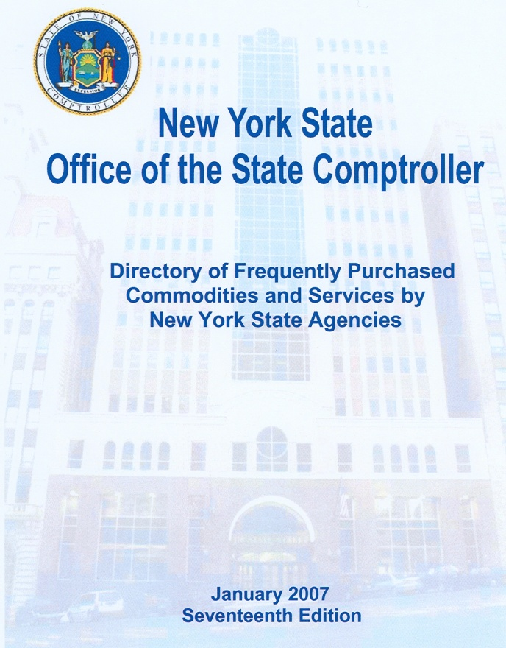
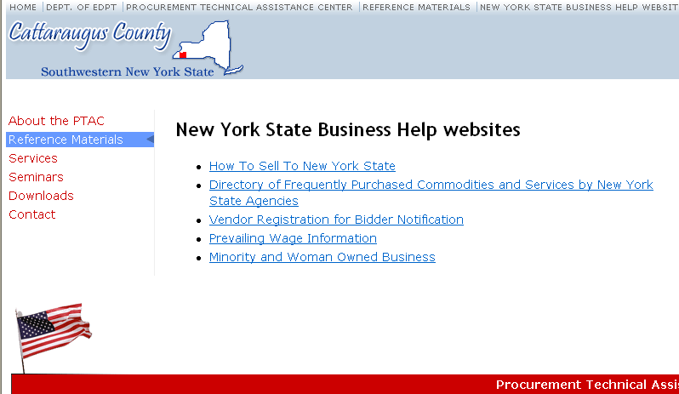



New York State Opportunities
*All graphics are hot linked
Notes:
The Directory of Frequently Purchased is available for download as a pdf. I suggest all businesses register on the OGS web site so you will be notified when an opportunity is available. The other graphics are hotlinked.

Slide 18
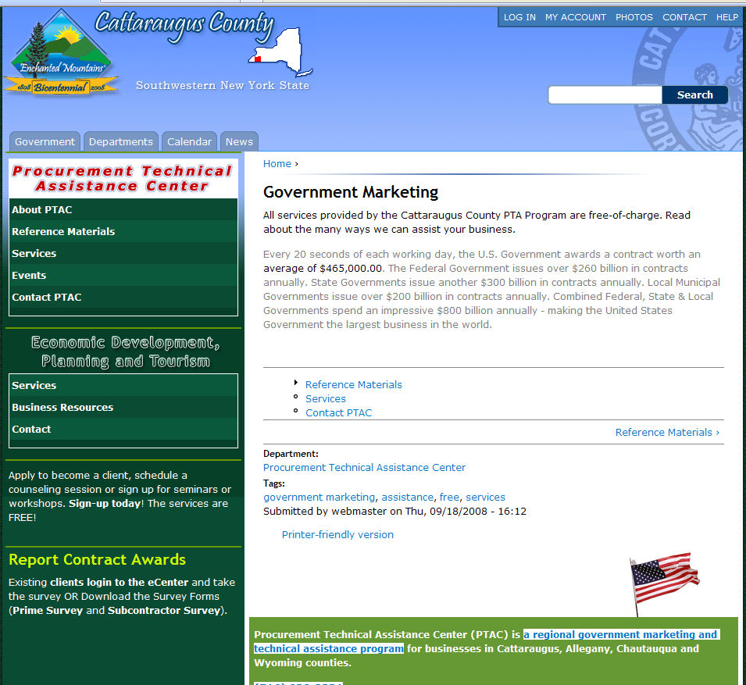
PTAC Website snap shot

Slide 19
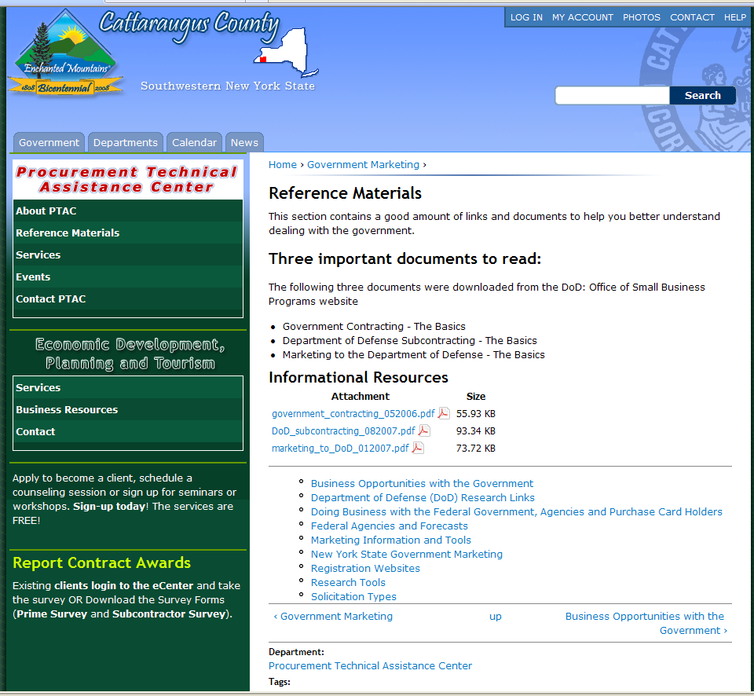
Notes:
Brief description of each link. Go into the Doing Business With link and show examples.

Slide 20
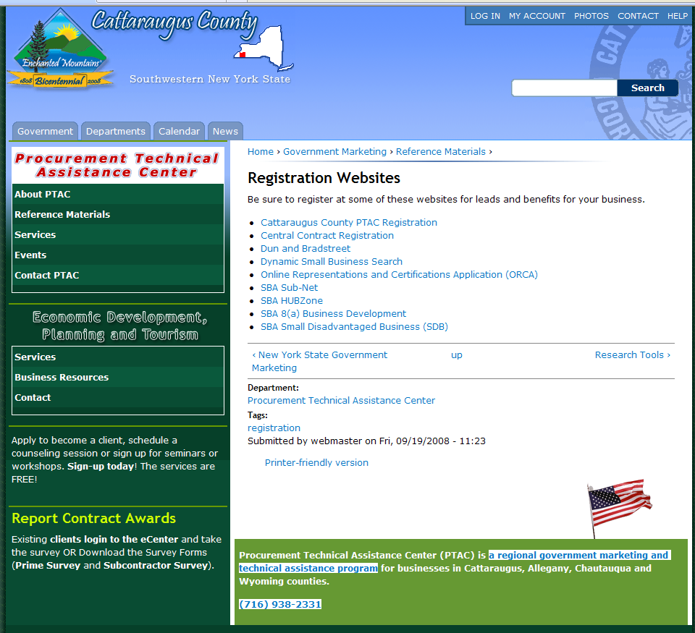

Slide 21
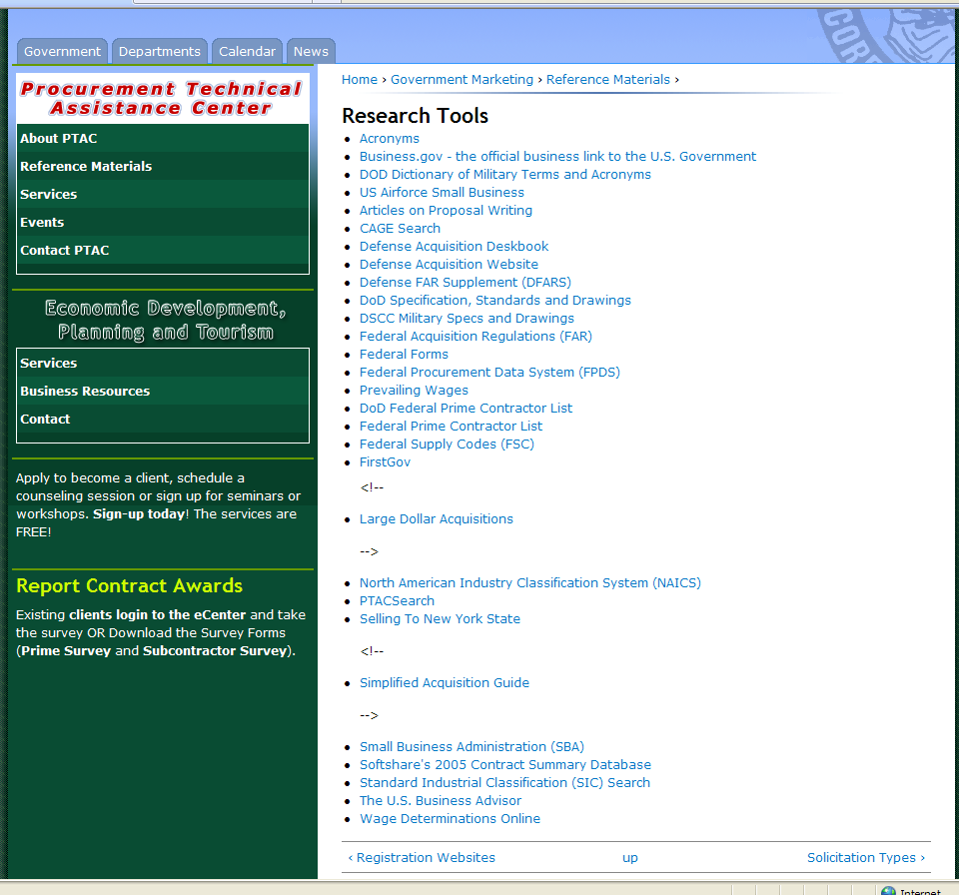

Slide 22
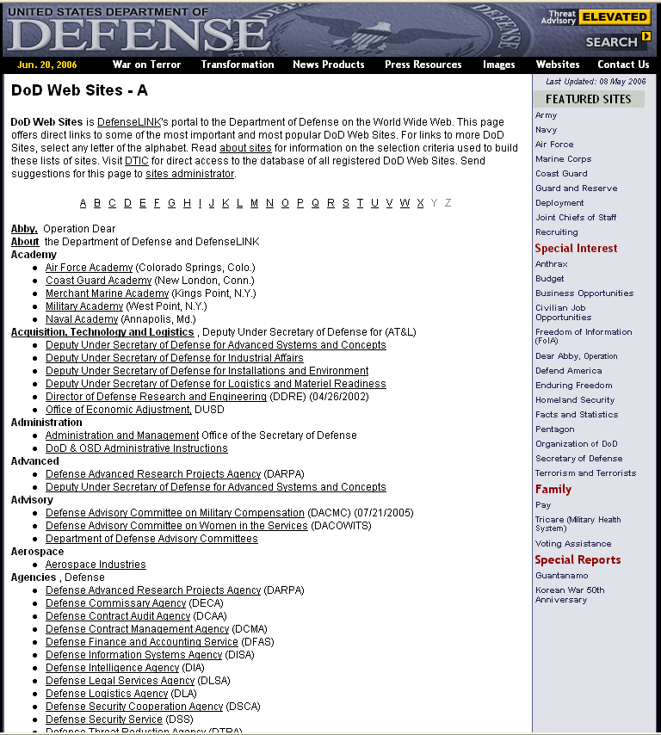
PTAC Website

Slide 23
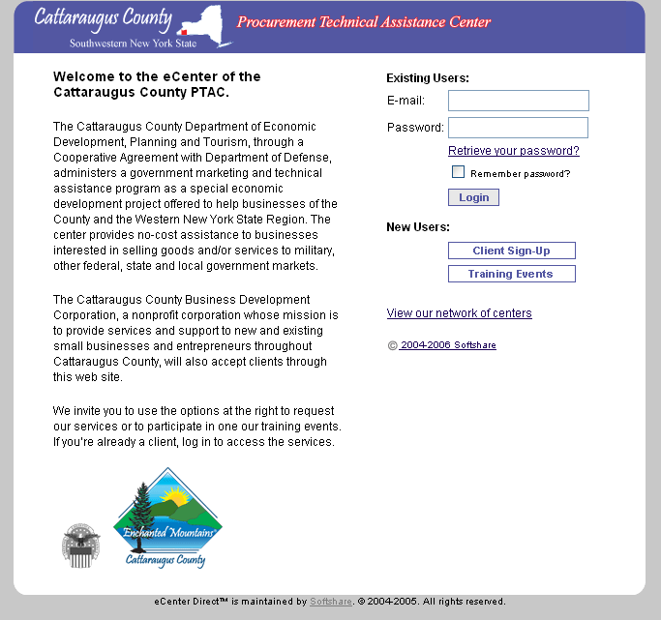
Web based e-Center….

Slide 24
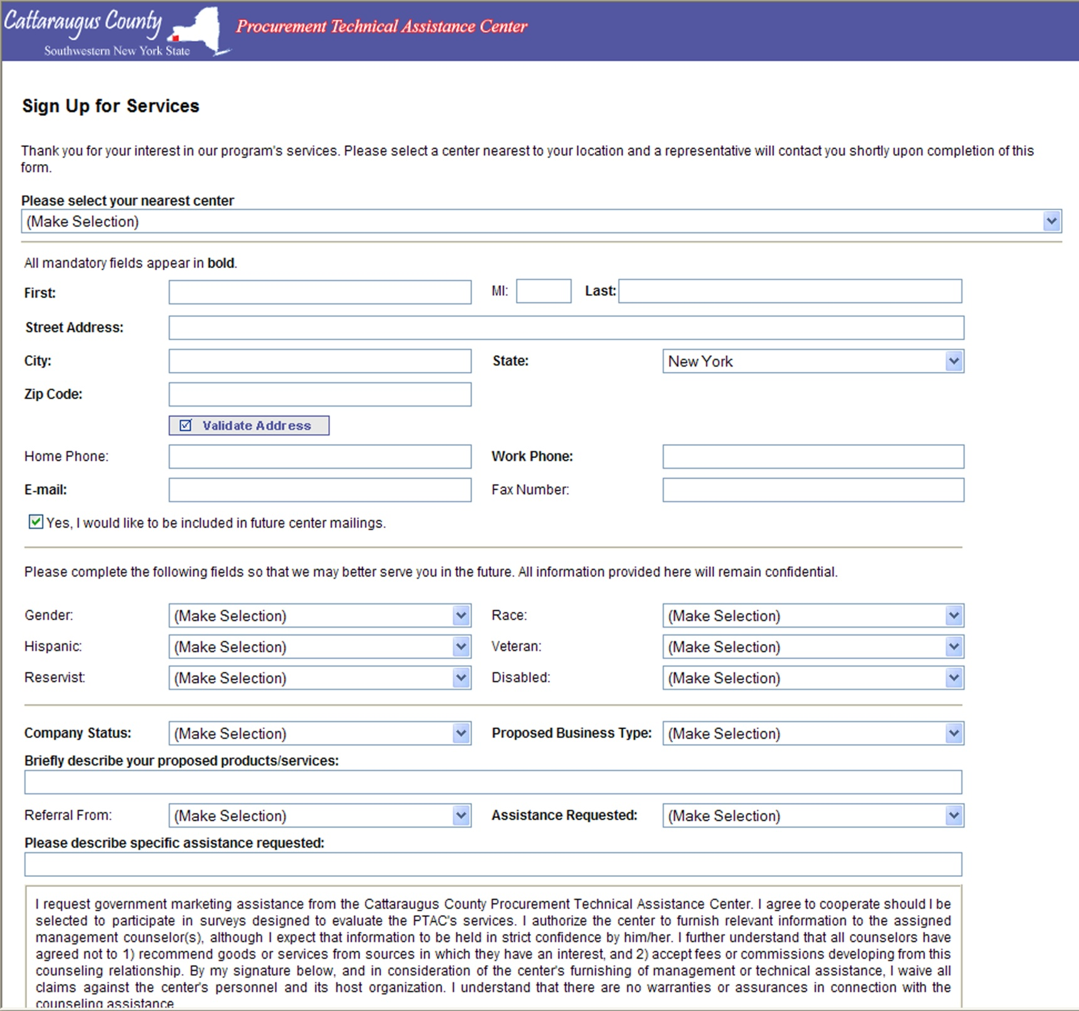

Slide 25

Questions….
Contact the
Cattaraugus County
Procurement Technical Assistance Center
www.cattco.org
http://ww2.cattco.org/procurement-technical-assistance-center/government-marketing
Joseph Williams
Program Manager
716-938-2331
JJWilliams@cattco.org
Lenora Leasure
Small Business Counselor
716-938-2311
LALeasure@cattco.org

